Slide 1

Consulting Arcady: Strategic advisers for excellence
CASE STUDY PROJECT

Slide 2

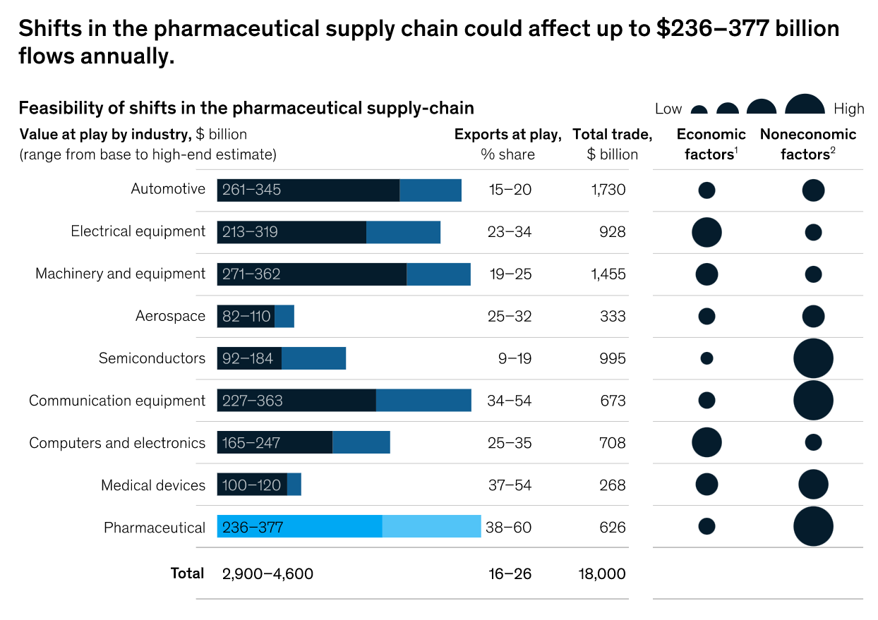
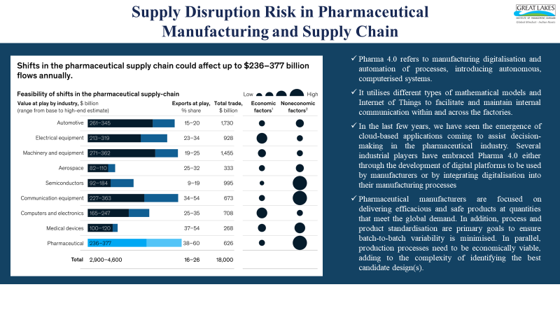
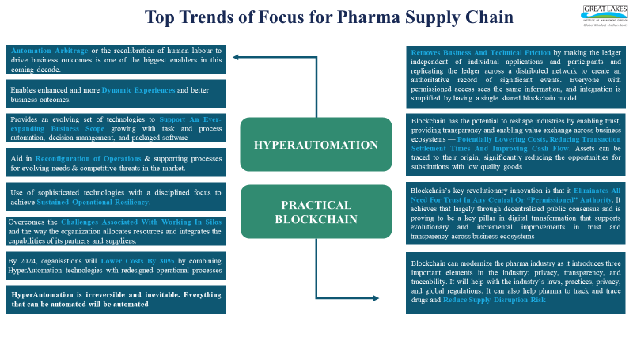
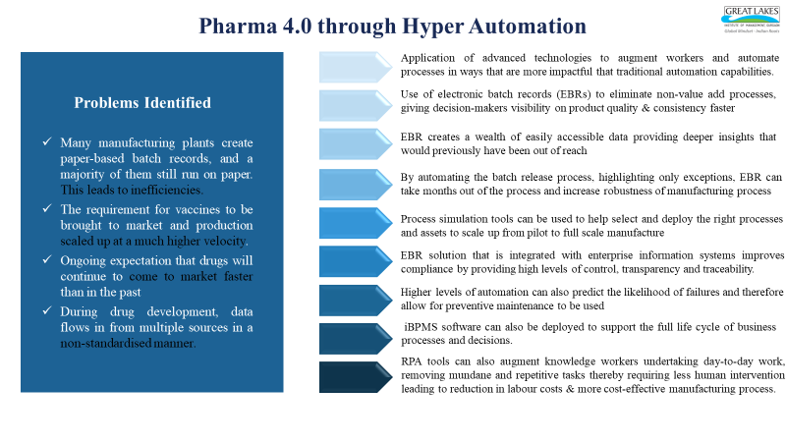
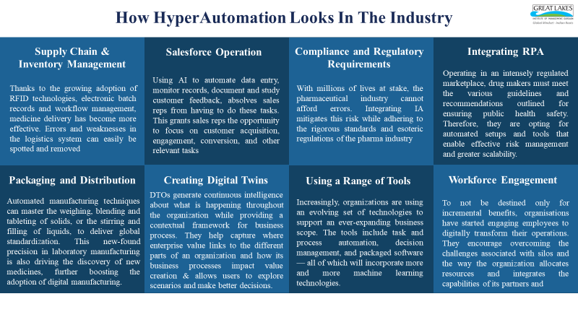
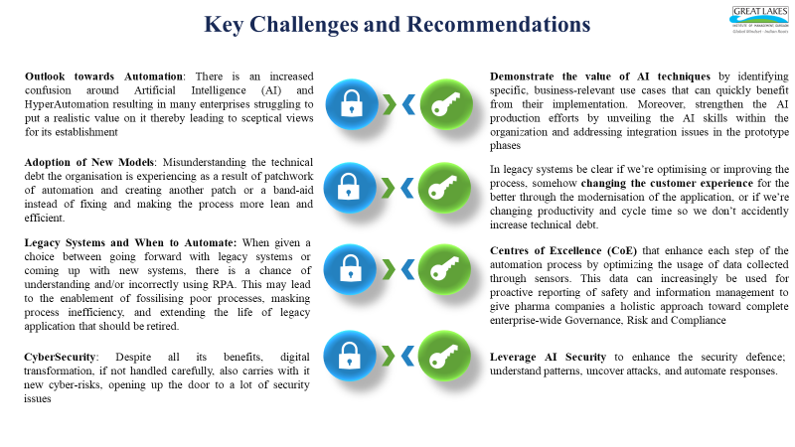
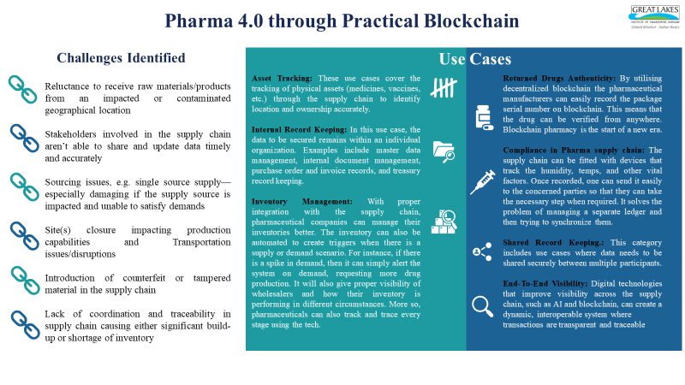
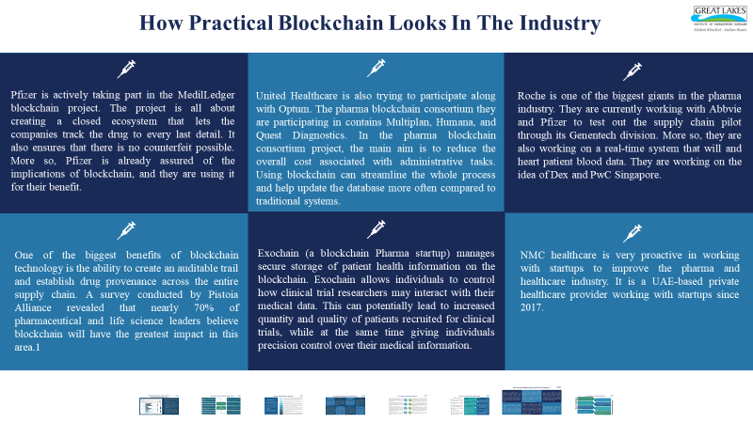
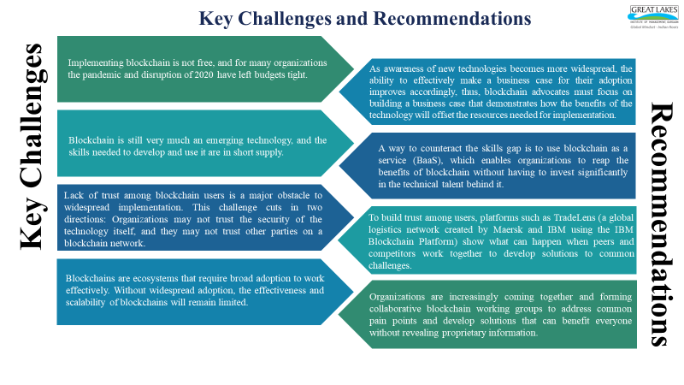
Supply Disruption Risk in Pharmaceutical Manufacturing and Supply Chain
Pharma 4.0 refers to manufacturing digitalisation and automation of processes, introducing autonomous, computerised systems.
It utilises different types of mathematical models and Internet of Things to facilitate and maintain internal communication within and across the factories.
In the last few years, we have seen the emergence of cloud-based applications coming to assist decision-making in the pharmaceutical industry. Several industrial players have embraced Pharma 4.0 either through the development of digital platforms to be used by manufacturers or by integrating digitalisation into their manufacturing processes
Pharmaceutical manufacturers are focused on delivering efficacious and safe products at quantities that meet the global demand. In addition, process and product standardisation are primary goals to ensure batch-to-batch variability is minimised. In parallel, production processes need to be economically viable, adding to the complexity of identifying the best candidate design(s).

Slide 3
Top Trends of Focus for Pharma Supply Chain
Automation Arbitrage or the recalibration of human labour to drive business outcomes is one of the biggest enablers in this coming decade.
Removes Business And Technical Friction by making the ledger independent of individual applications and participants and replicating the ledger across a distributed network to create an authoritative record of significant events. Everyone with permissioned access sees the same information, and integration is simplified by having a single shared blockchain model.
Enables enhanced and more Dynamic Experiences and better business outcomes.
Provides an evolving set of technologies to Support An Ever-expanding Business Scope growing with task and process automation, decision management, and packaged software
HYPERAUTOMATION
Blockchain has the potential to reshape industries by enabling trust, providing transparency and enabling value exchange across business ecosystems — Potentially Lowering Costs, Reducing Transaction Settlement Times And Improving Cash Flow. Assets can be traced to their origin, significantly reducing the opportunities for substitutions with low quality goods
Aid in Reconfiguration of Operations & supporting processes for evolving needs & competitive threats in the market.
Use of sophisticated technologies with a disciplined focus to achieve Sustained Operational Resiliency.
PRACTICAL BLOCKCHAIN
Blockchain’s key revolutionary innovation is that it Eliminates All Need For Trust In Any Central Or “Permissioned” Authority. It achieves that largely through decentralized public consensus and is proving to be a key pillar in digital transformation that supports evolutionary and incremental improvements in trust and transparency across business ecosystems
Overcomes the Challenges Associated With Working In Silos and the way the organization allocates resources and integrates the capabilities of its partners and suppliers.
By 2024, organisations will Lower Costs By 30% by combining HyperAutomation technologies with redesigned operational processes
Blockchain can modernize the pharma industry as it introduces three important elements in the industry: privacy, transparency, and traceability. It will help with the industry’s laws, practices, privacy, and global regulations. It can also help pharma to track and trace drugs and Reduce Supply Disruption Risk
HyperAutomation is irreversible and inevitable. Everything that can be automated will be automated

Slide 4
Pharma 4.0 through Hyper Automation
Application of advanced technologies to augment workers and automate processes in ways that are more impactful that traditional automation capabilities.
Problems Identified
Use of electronic batch records (EBRs) to eliminate non-value add processes, giving decision-makers visibility on product quality & consistency faster
Many manufacturing plants create paper-based batch records, and a majority of them still run on paper. This leads to inefficiencies.
The requirement for vaccines to be brought to market and production scaled up at a much higher velocity.
Ongoing expectation that drugs will continue to come to market faster than in the past
During drug development, data flows in from multiple sources in a non-standardised manner.
EBR creates a wealth of easily accessible data providing deeper insights that would previously have been out of reach
By automating the batch release process, highlighting only exceptions, EBR can take months out of the process and increase robustness of manufacturing process
Process simulation tools can be used to help select and deploy the right processes and assets to scale up from pilot to full scale manufacture
EBR solution that is integrated with enterprise information systems improves compliance by providing high levels of control, transparency and traceability.
Higher levels of automation can also predict the likelihood of failures and therefore allow for preventive maintenance to be used
iBPMS software can also be deployed to support the full life cycle of business processes and decisions.
RPA tools can also augment knowledge workers undertaking day-to-day work, removing mundane and repetitive tasks thereby requiring less human intervention leading to reduction in labour costs & more cost-effective manufacturing process.

Slide 5
How HyperAutomation Looks In The Industry
Supply Chain &
Inventory Management
Salesforce Operation
Compliance and Regulatory Requirements
Integrating RPA
Operating in an intensely regulated marketplace, drug makers must meet the various guidelines and recommendations outlined for ensuring public health safety. Therefore, they are opting for automated setups and tools that enable effective risk management and greater scalability.
Using AI to automate data entry, monitor records, document and study customer feedback, absolves sales reps from having to do these tasks. This grants sales reps the opportunity to focus on customer acquisition, engagement, conversion, and other relevant tasks
Thanks to the growing adoption of RFID technologies, electronic batch records and workflow management, medicine delivery has become more effective. Errors and weaknesses in the logistics system can easily be spotted and removed
With millions of lives at stake, the pharmaceutical industry cannot afford errors. Integrating IA mitigates this risk while adhering to the rigorous standards and esoteric regulations of the pharma industry
Packaging and Distribution
Creating Digital Twins
Using a Range of Tools
Workforce Engagement
Automated manufacturing techniques can master the weighing, blending and tableting of solids, or the stirring and filling of liquids, to deliver global standardization. This new-found precision in laboratory manufacturing is also driving the discovery of new medicines, further boosting the adoption of digital manufacturing.
DTOs generate continuous intelligence about what is happening throughout the organization while providing a contextual framework for business process. They help capture where enterprise value links to the different parts of an organization and how its business processes impact value creation & allows users to explore scenarios and make better decisions.
Increasingly, organizations are using an evolving set of technologies to support an ever-expanding business scope. The tools include task and process automation, decision management, and packaged software — all of which will incorporate more and more machine learning technologies.
To not be destined only for incremental benefits, organisations have started engaging employees to digitally transform their operations. They encourage overcoming the challenges associated with silos and the way the organization allocates resources and integrates the capabilities of its partners and

Slide 6


Key Challenges and Recommendations
Outlook towards Automation: There is an increased confusion around Artificial Intelligence (AI) and HyperAutomation resulting in many enterprises struggling to put a realistic value on it thereby leading to sceptical views for its establishment
Demonstrate the value of AI techniques by identifying specific, business-relevant use cases that can quickly benefit from their implementation. Moreover, strengthen the AI production efforts by unveiling the AI skills within the organization and addressing integration issues in the prototype phases
Adoption of New Models: Misunderstanding the technical debt the organisation is experiencing as a result of patchwork of automation and creating another patch or a band-aid instead of fixing and making the process more lean and efficient.
In legacy systems be clear if we’re optimising or improving the process, somehow changing the customer experience for the better through the modernisation of the application, or if we’re changing productivity and cycle time so we don’t accidently increase technical debt.
Legacy Systems and When to Automate: When given a choice between going forward with legacy systems or coming up with new systems, there is a chance of understanding and/or incorrectly using RPA. This may lead to the enablement of fossilising poor processes, masking process inefficiency, and extending the life of legacy application that should be retired.
Centres of Excellence (CoE) that enhance each step of the automation process by optimizing the usage of data collected through sensors. This data can increasingly be used for proactive reporting of safety and information management to give pharma companies a holistic approach toward complete enterprise-wide Governance, Risk and Compliance
CyberSecurity: Despite all its benefits, digital transformation, if not handled carefully, also carries with it new cyber-risks, opening up the door to a lot of security issues
Leverage AI Security to enhance the security defence; understand patterns, uncover attacks, and automate responses.

Slide 7
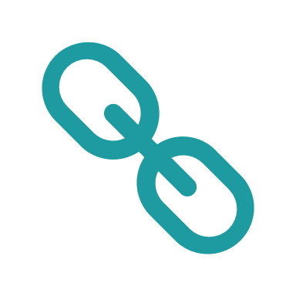


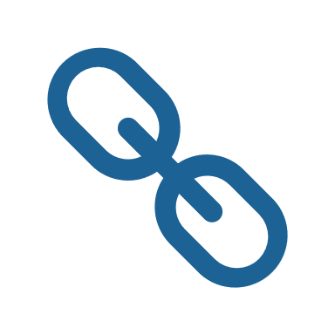





Pharma 4.0 through Practical Blockchain
Challenges Identified
Use Cases
Reluctance to receive raw materials/products from an impacted or contaminated geographical location
Stakeholders involved in the supply chain aren’t able to share and update data timely and accurately
Sourcing issues, e.g. single source supply—especially damaging if the supply source is impacted and unable to satisfy demands
Site(s) closure impacting production capabilities and Transportation issues/disruptions
Introduction of counterfeit or tampered material in the supply chain
Lack of coordination and traceability in supply chain causing either significant build-up or shortage of inventory
Asset Tracking: These use cases cover the tracking of physical assets (medicines, vaccines, etc.) through the supply chain to identify location and ownership accurately.
Internal Record Keeping: In this use case, the data to be secured remains within an individual organization. Examples include master data management, internal document management, purchase order and invoice records, and treasury record keeping.
Inventory Management: With proper integration with the supply chain, pharmaceutical companies can manage their inventories better. The inventory can also be automated to create triggers when there is a supply or demand scenario. For instance, if there is a spike in demand, then it can simply alert the system on demand, requesting more drug production. It will also give proper visibility of wholesalers and how their inventory is performing in different circumstances. More so, pharmaceuticals can also track and trace every stage using the tech.
Returned Drugs Authenticity: By utilising decentralized blockchain the pharmaceutical manufacturers can easily record the package serial number on blockchain. This means that the drug can be verified from anywhere. Blockchain pharmacy is the start of a new era.
Compliance in Pharma supply chain: The supply chain can be fitted with devices that track the humidity, temps, and other vital factors. Once recorded, one can send it easily to the concerned parties so that they can take the necessary step when required. It solves the problem of managing a separate ledger and then trying to synchronize them.
Shared Record Keeping.: This category includes use cases where data needs to be shared securely between multiple participants.
End-To-End Visibility: Digital technologies that improve visibility across the supply chain, such as AI and blockchain, can create a dynamic, interoperable system where transactions are transparent and traceable

Slide 8
How Practical Blockchain Looks In The Industry
Pfizer is actively taking part in the MedilLedger blockchain project. The project is all about creating a closed ecosystem that lets the companies track the drug to every last detail. It also ensures that there is no counterfeit possible. More so, Pfizer is already assured of the implications of blockchain, and they are using it for their benefit.
United Healthcare is also trying to participate along with Optum. The pharma blockchain consortium they are participating in contains Multiplan, Humana, and Quest Diagnostics. In the pharma blockchain consortium project, the main aim is to reduce the overall cost associated with administrative tasks. Using blockchain can streamline the whole process and help update the database more often compared to traditional systems.
Roche is one of the biggest giants in the pharma industry. They are currently working with Abbvie and Pfizer to test out the supply chain pilot through its Genentech division. They also intend to collaborate on a pilot project to study the safe
and secure transmission of the INR results of patients on anti-coagulation therapy from the home monitoring device to the hospital information system.
One of the biggest benefits of blockchain technology is the ability to create an auditable trail and establish drug provenance across the entire supply chain. A survey conducted by Pistoia Alliance revealed that nearly 70% of pharmaceutical and life science leaders believe blockchain will have the greatest impact in this area.1
Exochain (a blockchain Pharma startup) manages secure storage of patient health information on the blockchain. Exochain allows individuals to control how clinical trial researchers may interact with their medical data. This can potentially lead to increased quantity and quality of patients recruited for clinical trials, while at the same time giving individuals precision control over their medical information.
NMC healthcare is very proactive in working with startups to improve the pharma and healthcare industry. It is a UAE-based private healthcare provider working with startups since 2017.

Slide 9
Key Challenges and Recommendations
Implementing blockchain is not free, and for many organizations the pandemic and disruption of 2020 have left budgets tight.
As awareness of new technologies becomes more widespread, the ability to effectively make a business case for their adoption improves accordingly, thus, blockchain advocates must focus on building a business case that demonstrates how the benefits of the technology will offset the resources needed for implementation.
Key Challenges
Blockchain is still very much an emerging technology, and the skills needed to develop and use it are in short supply.
A way to counteract the skills gap is to use blockchain as a service (BaaS), which enables organizations to reap the benefits of blockchain without having to invest significantly in the technical talent behind it.
Lack of trust among blockchain users is a major obstacle to widespread implementation. This challenge cuts in two directions: Organizations may not trust the security of the technology itself, and they may not trust other parties on a blockchain network.
To build trust among users, platforms such as TradeLens (a global logistics network created by Maersk and IBM using the IBM Blockchain Platform) show what can happen when peers and competitors work together to develop solutions to common challenges.
Recommendations
Blockchains are ecosystems that require broad adoption to work effectively. Without widespread adoption, the effectiveness and scalability of blockchains will remain limited.
Organizations are increasingly coming together and forming collaborative blockchain working groups to address common pain points and develop solutions that can benefit everyone without revealing proprietary information.

Slide 10

Thank you!
Submitted by: Team Noor
Vicky Singh Nishant Sharma

